Slide 1
Intro to Digital Images and their Processing
CSE 4883: Digital Image Processing
Md. Tanvir Raihan
Slide Credit:Raiyan Rahman Sir

Slide 2
Image – Digital Image
An image is a two-dimensional function f(x,y), where x and y are the spatial (plane) coordinates, and the amplitude of f at any pair of coordinates (x,y) is called the intensity of the image at that level.
If x,y and the amplitude values of f are finite and discrete quantities, we call the image a digital image. A digital image is composed of a finite number of elements called pixels, each of which has a particular location and value.

Slide 3
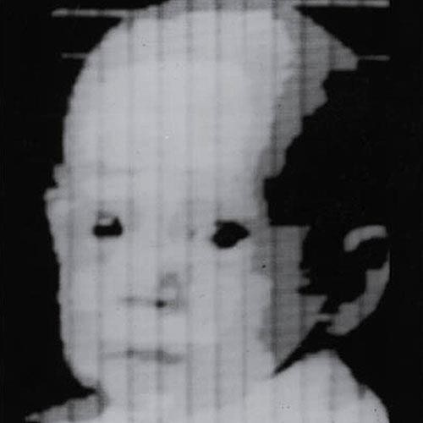
First Digital Photograph

Slide 4
Types of an image
BINARY IMAGE– The binary image as its name suggests, contain only two pixel elements i.e 0 & 1,where 0 refers to black and 1 refers to white. This image is also known as Monochrome.
BLACK AND WHITE IMAGE– The image which consist of only black and white color is called BLACK AND WHITE IMAGE.
8 bit COLOR FORMAT– It is the most famous image format. It has 256 different shades of colors in it and commonly
known as Grayscale Image. In this format, 0 stands for Black, and 255 stands for white, and 127 stands for gray.
16 bit COLOR FORMAT– It is a color image format. It is also known as High Color Format. In this format the distribution of color is not as same as Grayscale image. With 16-bit color, also called High color, computers and monitors can display as many as 65,536 colors, which is adequate for most uses. However, graphic intensive video games and higher resolution video can benefit from and take advantage of the higher color depths.
24 bit COLOR FORMAT - Using 24-bit color, also called True color, computers and monitors can display as many as 16,777,215 different color combinations.
32 bit COLOR FORMAT - Like 24-bit color, 32-bit color supports 16,777,215 colors but has an alpha channel it can create more convincing gradients, shadows, and transparencies. With the alpha channel 32-bit color supports 4,294,967,296 color combinations.

Slide 5
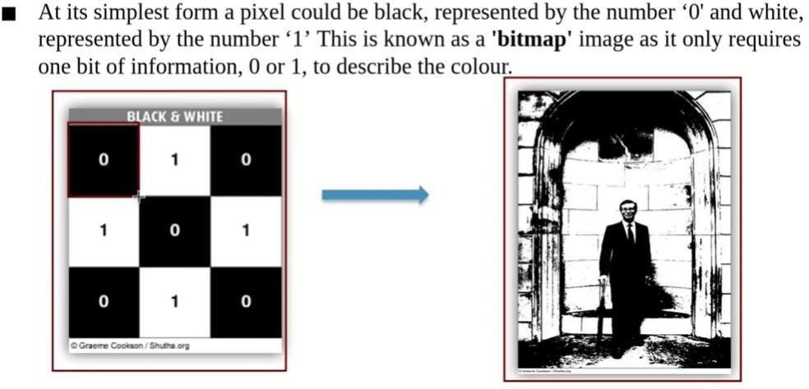
Bitmap image

Slide 6
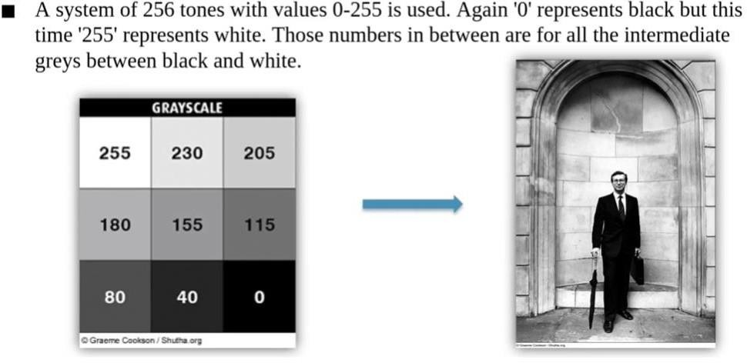
Grayscale Image – 8 bit

Slide 7
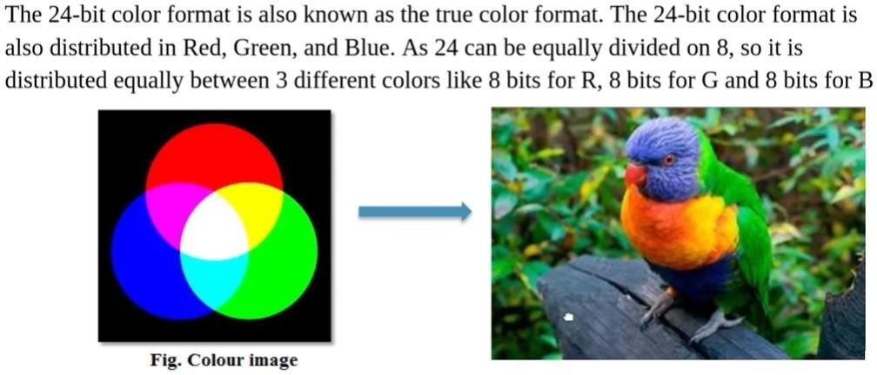
RGB – 24 bit

Slide 8
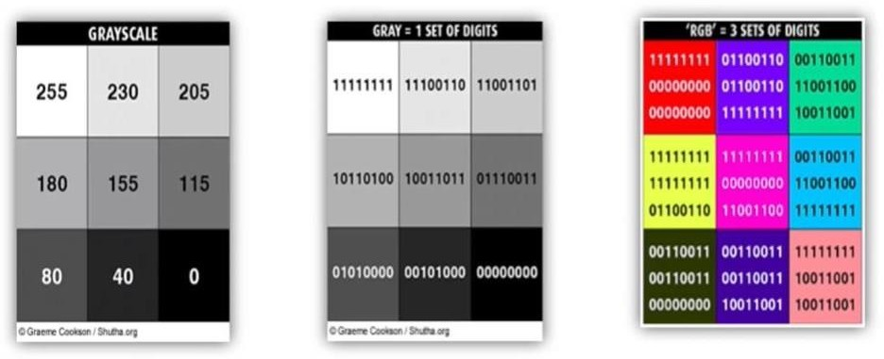
How a computer sees the numbers 0 to 255
Demo: https://pixspy.com/

Slide 9
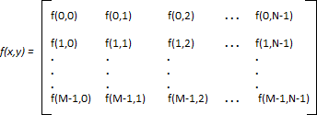
Image as a Matrix
As we know, images are represented in rows and columns we have the following syntax in which images are represented:
The right side of this equation is digital image by definition. Every element of this matrix is called image element , picture element , or pixel.

Slide 10
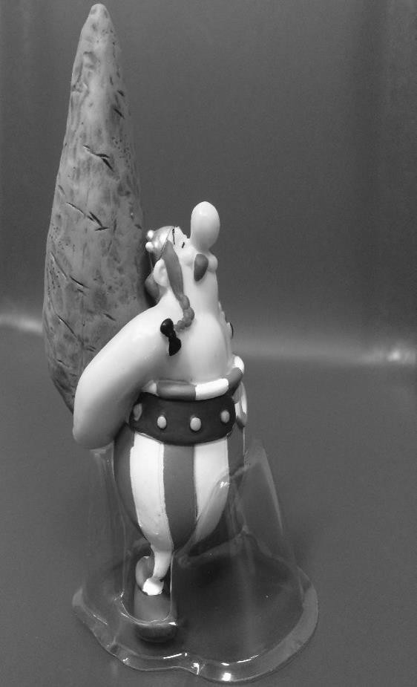
Consider the following image (2724x2336 pixels) to be 2D function or a matrix with rows and columns
Pixel intensity value
f(1,1) = 103
Pixel location
In 8-bit representation Pixel intensity values change between 0 (Black) and 255 (White)
rows columns
f(645:650,1323:1328) =
83 | 82 | 82 | 82 | 82 | 82
82 | 82 | 82 | 81 | 81 | 81
82 | 82 | 81 | 81 | 80 | 80
82 | 82 | 81 | 80 | 80 | 79
80 | 79 | 78 | 77 | 77 | 77
80 | 79 | 78 | 78 | 77 | 77
f(2724,2336) = 88

Slide 11
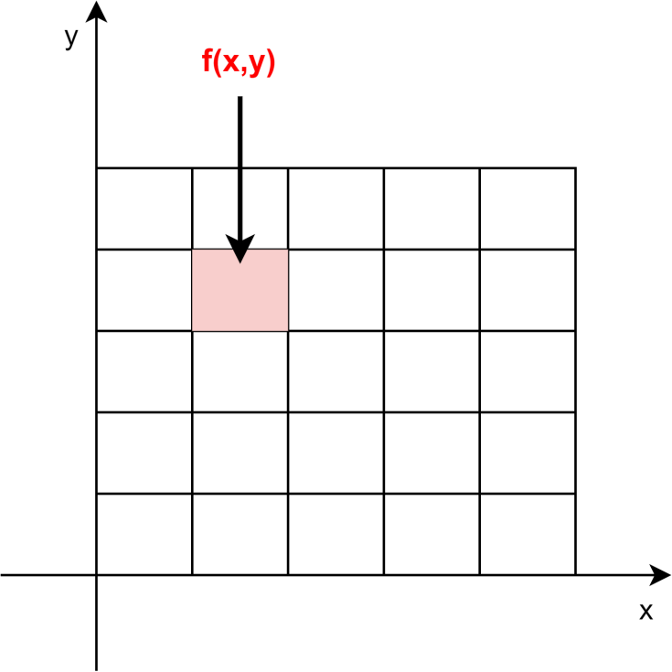
From Camera to Digital Image
We can capture a picture using the sensors in imaging tools, such as a camera. The sensors produce an image in the form of an analog signal, which is then digitized to produce a digital image.
A digital image is a two-dimensional function where and indicate the position in an image. The function holds a discrete value called the intensity value. Let’s see an example of the visual representation of spatial coordinates and amplitude of a digital image:

Slide 12
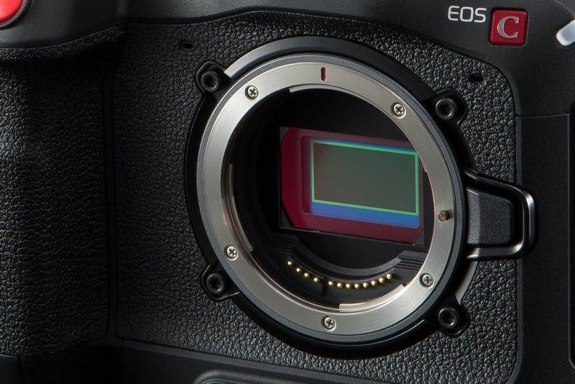
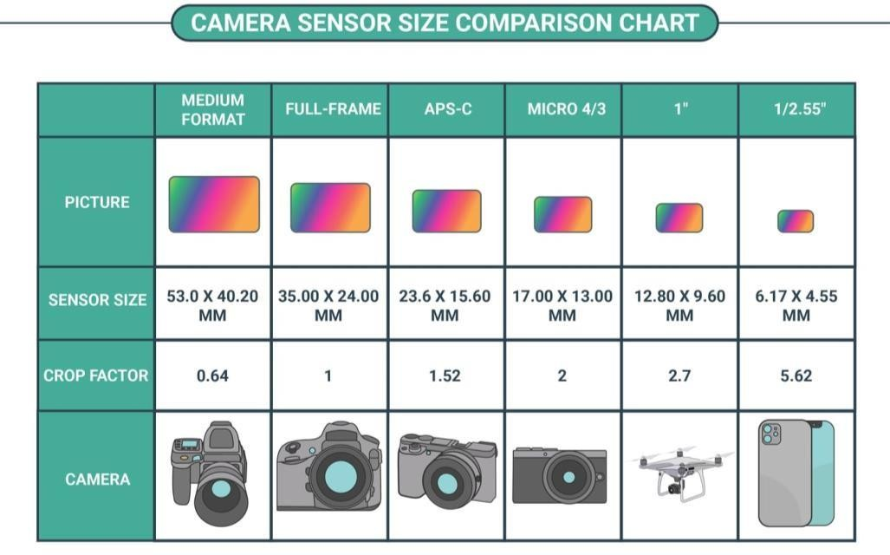
From Camera to Digital Image

Slide 13
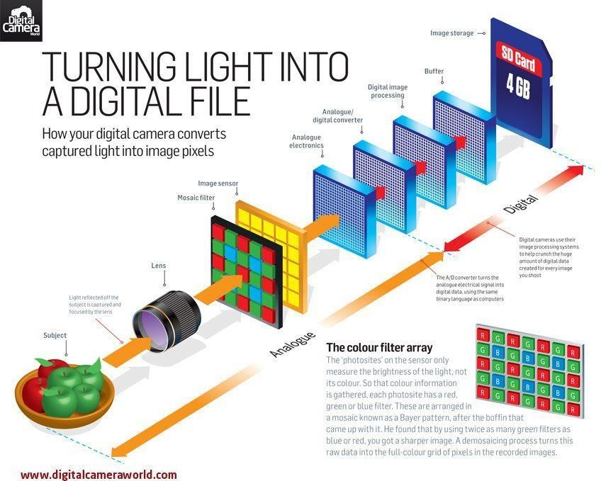
From Camera to Digital Image
We use sampling and
quantization for this.

Slide 14
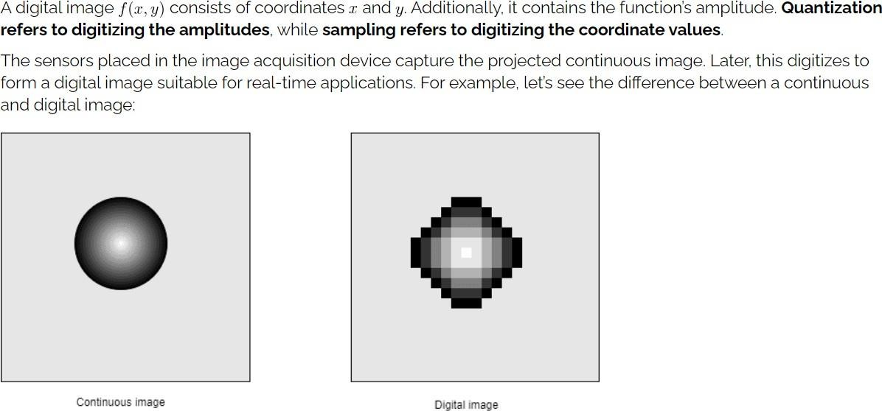
Sampling and Quantization

Slide 15
Sampling and Quantization
Objective –
To generate digital images from sensed data.
The output of most sensors is a continuous voltage waveform whose amplitude and spatial behavior are related to the physical phenomenon being sensed.
We need to convert the continuous sensed data into a digital format.
Techniques –
Sampling
Quantization
Sampling and quantization operations are part of the image processing method that converts
continuous voltage signals obtained from sensors into digital images.

Slide 16
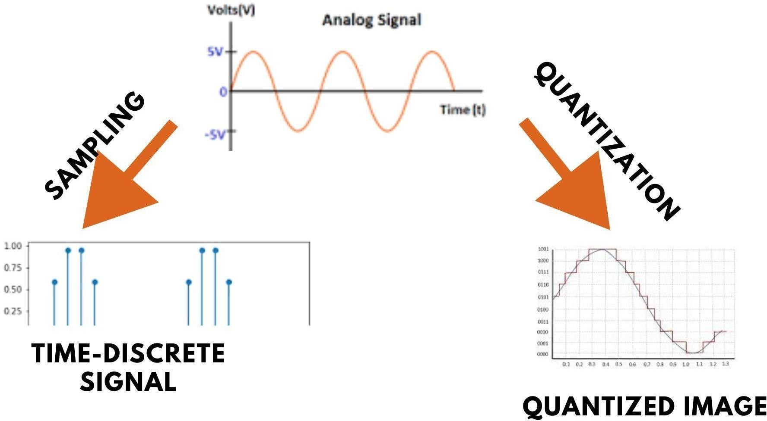
Sampling and Quantization

Slide 17
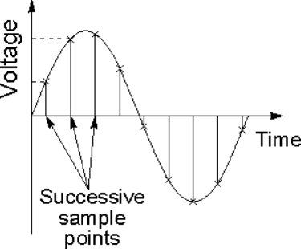
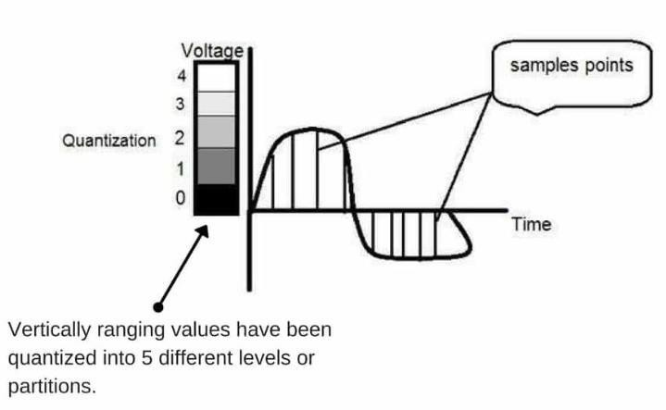
Sampling and Quantization

Slide 18
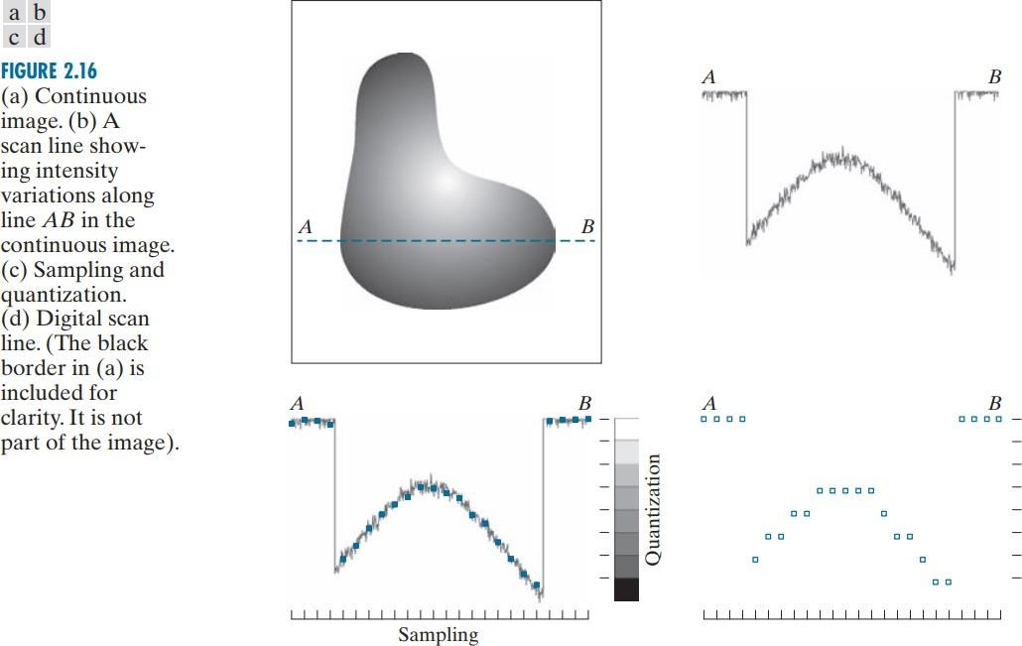
Sampling and
Quantization
An image may be continuous with respect to the x- and y-coordinates, and also in amplitude.
To digitize it, we have to sample the function in both coordinates and also in amplitude.
Digitizing the coordinate values is called
sampling.
Digitizing the amplitude values is called quantization.

Slide 19
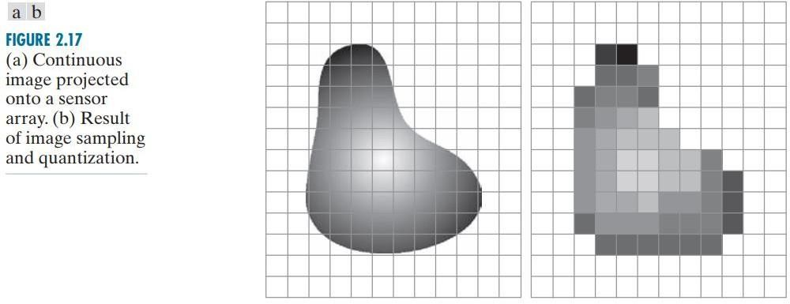
Sampling and Quantization

Slide 20
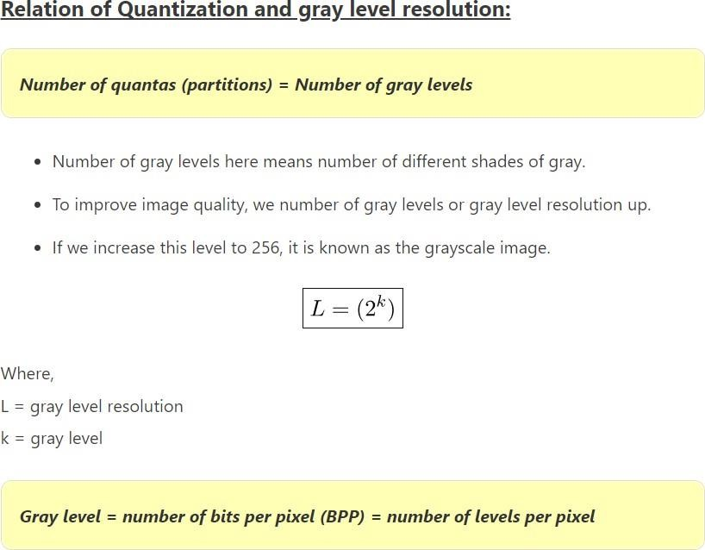
Sampling and Quantization

Slide 21
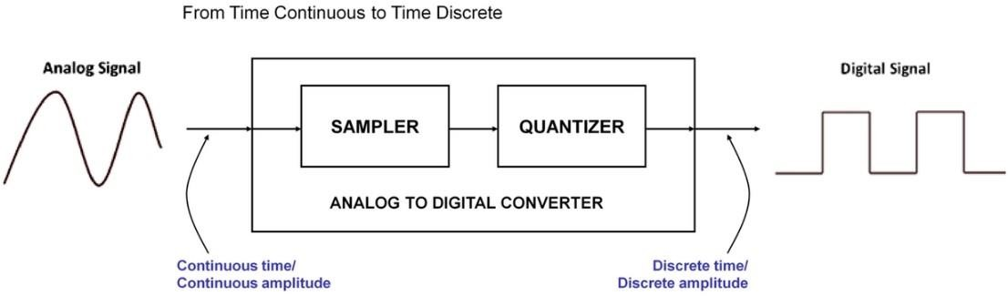
Sampling and Quantization

Slide 22
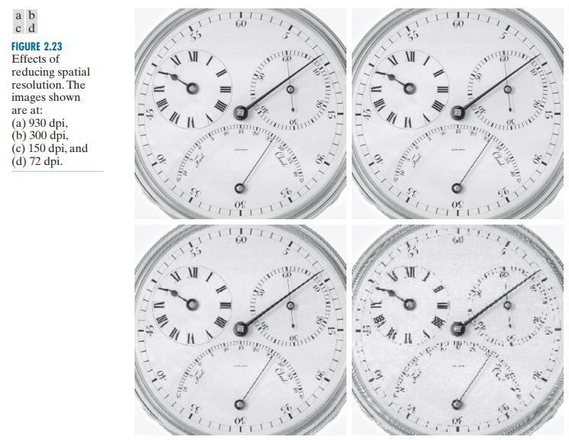
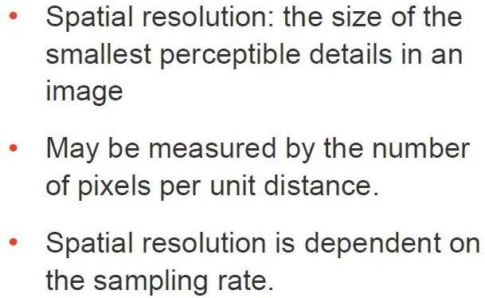
Spatial Resolution
DPI stands for Dots per Inch

Slide 23
Intensity Resolution

Slide 24
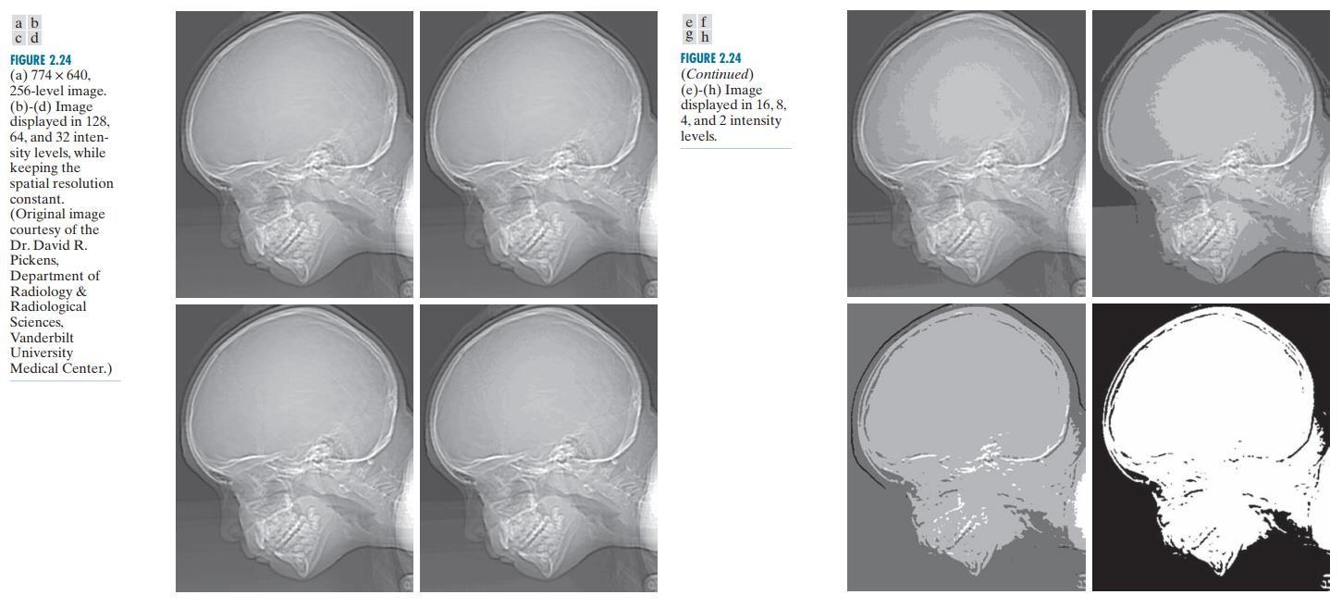
Intensity Resolution

Slide 25
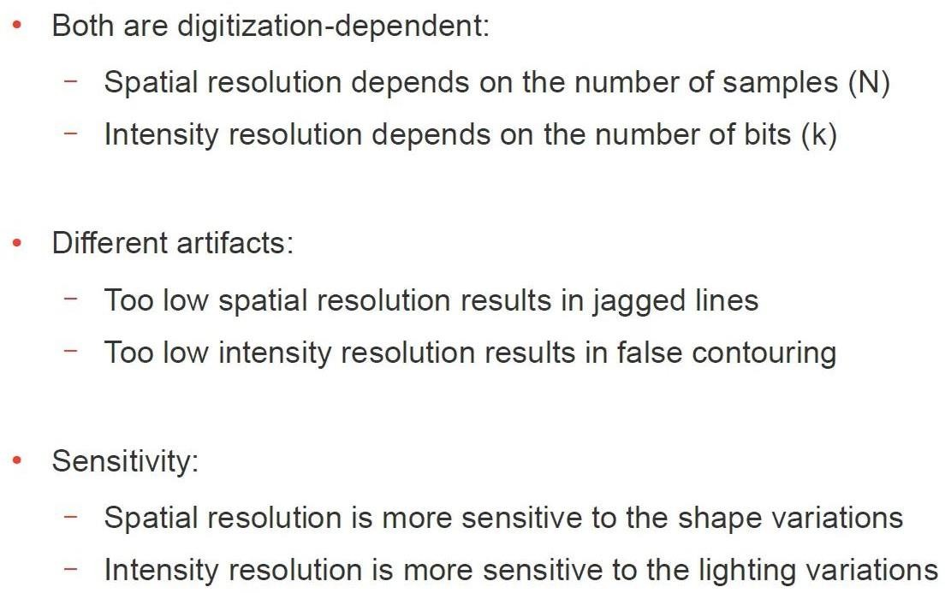
Spatial and Intensity Resolution

Slide 26
Some ways to display and resize images in python
Link:
https://www.askpython.com/python/examples/display-images-using-python Link:
https://www.dopinger.com/blog/how-to-resize-an-image-in-python

